Slide 1



פרוססור דזיין אנד ממורי מודלז
Core C++ 2026
20-21Oct. 2026 :: Tel-Aviv
אופק שילון
Speedata.io

Slide 2

Pseudo quote:
  “… atomic release makes the write visible to other threads…”
  A value becoming-visible is separate from writing it?
  The order in which writes become visible isn’t
  the program order?
Core Problem:
  Huh?

Slide 3
Example Program
Writer Core
Reader Core
NEW --> data
R1 <-- ready
TRUE --> ready
if !R1: goto Load_R1
R2 <-- data

Slide 4
Strict Consistency
Writer Core
Reader Core
NEW --> data
R1 <-- ready
TRUE --> ready
if !R1: goto Load_R1
R2 <-- data

Slide 5
Sequential Consistency (SC)
Writer Core
Reader Core
NEW --> data
R1 <-- ready
TRUE --> ready
if !R1: goto Load_R1
R2 <-- data

Slide 6
Sequential Consistency (SC)
NEW --> data
TRUE --> ready
R1 <-- ready = TRUE
R2 <-- data = NEW

Slide 7
Sequential Consistency (SC)
R1 <-- ready = FALSE
NEW --> data
R1 <-- ready = FALSE
TRUE --> ready
R1 <-- ready = FALSE
R1 <-- ready = TRUE
R2 <-- data = NEW

Slide 8
Why not SC?
What can cause cores to disagree on memory contents, at a specific point in time?
What can cause cores to disagree on order of memory operations?
What does it mean for a write to memory to be visible to all threads?

Slide 9
Answers

Slide 10
Non-answer: private caches
Memory
L2/L3: Shared Caches
L1 Cache
L1 Cache
Core
Core

Slide 11
Non-answer: private caches
Memory
deadcafe
deadcafe
L1 Cache
L1 Cache
deadcafe
deadc9fe
Core
Core

Slide 12
Non-answer: private caches
Memory
deadcafe
L1 Cache
L1 Cache
deadcafe
deadc9fe
deadc9fe
?
Core
Core

Slide 13
Cache Coherence
Modified
Cache line states:
Cache coherence protocols:
  MESI
  (MOESI, MESIF, ACE/CHI…)
Valid
Exclusive
Shared
Invalid
Invalid

Slide 14
Answer #1: Invalidate queues
Memory
L1 Cache
L1 Cache
deadcafe
deadc9fe
deadcafe
deadcafe
Core
Core

Slide 15
Answer #1: Invalidate queues
L1 Cache
L1 Cache
Invalidate
queue
deadcafe
deadcafe
deadc9fe
data? deadcafe
data? deadc9fe
Core
Core

Slide 16
Answer #1: Invalidate queues
Writer Core
NEW --> data
Reader Core
TRUE --> ready
R1 <-- ready
Invalid
if !R1 goto Load1
R2 <-- data
Valid
ready = TRUE
data = OLD

Slide 17
Answer #2: non multi-copy atomicity
L1 Cache
L1 Cache
L1 Cache
OLD
NEW
OLD
OLD
NEW
OLD
Core
Core
Core

Slide 18
Write Buffers
L1 Cache
deadc9fe
Core

Slide 19
Write Buffers
L1 Cache
Write
buffer
NEW --> data
Core

Slide 20
Write Buffers
Caches + Memory
NEW --> data
Core
Core
data?
NEW
data?
OLD

Slide 21
FIFO write buffers
Caches + Memory
data? NEW
ready? TRUE
data? OLD
ready? FALSE
data? NEW
ready? FALSE
NEW --> data
TRUE --> ready
Core
Core

Slide 22
Dekker/Peterson Algorithm
_{taken1 = FALSE, taken2 = FALSE}
TRUE --> taken1
TRUE --> taken2
R1 <-- taken2
R2 <-- taken1
Core
Core

Slide 23
Dekker/Peterson Algorithm
_{taken1 = FALSE, taken2 = FALSE}
TRUE --> taken1
TRUE --> taken2
R1 <-- taken2
TRUE
R2 <-- taken1
Core
Core

Slide 24
Dekker/Peterson Algorithm
_{taken1 = FALSE, taken2 = FALSE}
TRUE --> taken2
TRUE --> taken1
R1 <-- taken2
TRUE
R2 <-- taken1
Core
Core

Slide 25
FIFO write buffers
Caches/Memory: taken1 = FALSE, taken2 = FALSE
taken2? FALSE
TRUE --> taken1
TRUE --> taken2
taken1? FALSE
Core
Core

Slide 26
Intel Memory Model
TSO: Total Store Order :
  Stores cannot bypass other stores
  Loads can bypass older stores.
  [we didn’t discuss explicitly:]
  Stores cannot bypass older loads
  Loads cannot bypass other loads
Intuition: FIFO write buffers

Slide 27
Coalescing write buffers
Coalesce writes to the same cache line

Slide 28
Coalescing write buffers
Caches + Memory
dummy? 0
data? OLD
ready? FALSE
1 --> dummy
TRUE --> ready
NEW --> data
Core
Core

Slide 29
Coalescing write buffers
Caches + Memory
1 --> dummy
TRUE --> ready
dummy? 1
data? OLD
ready? TRUE
NEW --> data
dummy? 0
data? OLD
ready? FALSE
Core
Core

Slide 30
Out of Order – Memory Ops
Load-Store-Queue
Instruction Queue
L/S
Addr
Val
Complete
Memory/Caches
R8 <-- [R1]
L
0x10
R1 = R1–R2
S
R2
1234
0x20
R4 --> [R2]
L
R1
1234
R2 = R3/R9
R3 <-- [R6]
Reservation Stations
RS1
/
R3
R9
RS2
Issue
RS3
Dispatch

Slide 31
Out of Order – Memory Ops
Load-Store-Queue
Instruction Queue
L/S
Addr
Val
Complete
Memory/Caches
R8 <-- [R1]
L
0x10
5678
✓1
WB
R1 = R1–R2
S
11
1234
✓5
0x20
R4 --> [R2]
L
R1
1234
✓3
R2 = R3/R9
Register File
R3 <-- [R6]
Reservation Stations
R1:
RS1
/
R3
R9
✓2
R2:
R2: 11
R3:
RS2
R3:5678
RS3
Commit
R4:

Slide 32
What could go wrong?
Load-Store-Queue
Memory/Caches
L/S
Addr
Val
Complete
L
0x10
L
0x30

Slide 33
Answer #4: Out-of-Order Execution
Writer Core
Reader Core
(=OLD!)
NEW --> data
TRUE --> ready
R1 <-- ready
(=TRUE)
R2 <-- data
R2 <-- data

Slide 34
More Rabbit Holes for the Curious
ROB (reorder buffer)
RAT (register alias table)
PRF (Physical Register File)
MOB (Memory Order Buffer)
Separation of LQ/SQ,
Virtual/physical addressing

Slide 35
Answer #5: Speculative Execution
Memory/Caches
_{if (ready) {}
_{R2 <-- data}
…
TRUE
OLD

Slide 36
Some Answers
What can cause cores to disagree on memory contents, at a specific point in time?
What can cause cores to disagree on order of memory operations?
  → Invalidate queues, write buffers, out of order execution, speculative loads
What does it mean for a write to memory to be visible to all threads?
  → To have the store commit, drained from the write buffer and finalize cache coherency propagation.

Slide 37
Solutions
Fences,
load-acquire, store-release, RMW

Slide 38
Fences: Full
X86-64: MFENCE (Memory Fence)
ARM: DSB (Data Sync Barrier)
  Wait until previous stores are:
    Committed in the LSQ
    Drained from the write buffer
    Visible everywhere (invalidate requests processed)
  Wait until previous loads are retired
  Act as a speculation barrier
Safest + most expensive

Slide 39
Fences: Full
ARM: DSB (Data Store Barrier)
ARM: DMB SY (Data Memory Barrier, System-wide)
Operation:
  Enforce ordering, not completion
  At: Write buffers, LSQ …
Cheaper alternative with mostly-compatible semantics
store
store
load
load

Slide 40
ARM: Acquire / Release
dmb ld
dmb st
store
load
load
store
store
load

Slide 41
ARM: Acquire / Release
dmb ld
dmb st
ldar – Load Acquire
store
load
load
stlr – Store Release
store
store
load

Slide 42
ARM: Acquire / Release
Writer Core
Reader Core
NEW --> data
ldar R1, ready
TRUE --> ready
R1 <-- ready
stlr ready, TRUE
if !R1 goto LoadReady
R2 <-- data

Slide 43
ARM: Acquire / Release
NEW --> data
ldar R1, ready
stlr ready, TRUE
if !R1 goto LoadReady
R2 <-- data
int data = 0;
std::atomic<bool> ready = 0;
int read() {
while (!ready.load(memory_order_acquire));
return data;
}
void write() {
data = NEW;
ready.store(true,
memory_order_release);
}

Slide 44
C++ std::memory_order
For stores:
  memory_order_release
For loads:
  memory_order_acquire
  (==memory_order_consume)
For Read-Modify-Write (RMW) ops, such as +=:
  memory_order_acquire, memory_order_release
  memory_order_acq_rel: acquire AND release
For all:
  memory_order_relaxed: no order guarantees
  memory_order_seq_cst: full sequential consistency

Slide 45
Read-Modify-Write
C++ atomic<> ops:
  +=, -=, &=, |=, ^=
    fetch_add(), fetch_sub(), fetch_and(), fetch_or(), fetch_xor()
  exchange()
  compare_exchange_weak(), compare_exchange_strong()
In assembly:
  X86-64: LOCK prefix (lock add, lock xchg)
  ARM: LL/SC
    + dedicated instructions, in ARM v8.1+

Slide 46
Read-modify-write: x86-64
L1 Cache
L1 Cache
deadcafe
deadcafe
deadc9fe
Core

Slide 47
Read-modify-write: x86-64
L1 Cache
L1 Cache
L1 Cache
deadcafe
deadcafe
deadc9fe
beadcafe
Core

Slide 48
Read-modify-write: ARM
L1 Cache
deadcafe
X
deadc9fe
LDXR
STXR
Core

Slide 49

Read-modify-write: ARM
L1 Cache
L1 Cache
X
deadcafe
beadcafe
LDXR
STXR
STR
Core
Core

Slide 50
Read-modify-write: ARM
L1 Cache
  compare_exchange_weak(), compare_exchange_strong()
deadcafe
LDXR
STXR
Core

Slide 51
Read-modify-write: ARM
LDXR/STXR extension:
  LDAXR – load-acquire exclusive register
  STLXR – store-release exclusive register
  Additionally enforce acquire/release ordering, same as LDAR/STLR
  Necessary to actually be usable in locks
Riddle: why is the exclusive monitor needed?
  Why not a special “store that fails if the dest cache line is invalidated”?

Slide 52
Memory Models

Slide 53
Recall:
Strong:
  Strict Consistency
  Sequential Consistency (SC)
Sort-of strong:
  TSO
    New loads can bypass old stores

Slide 54
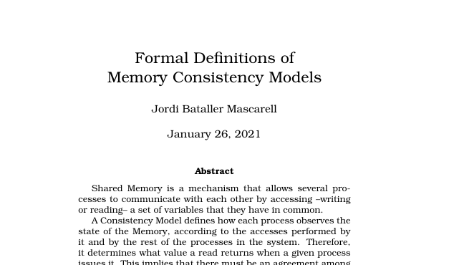
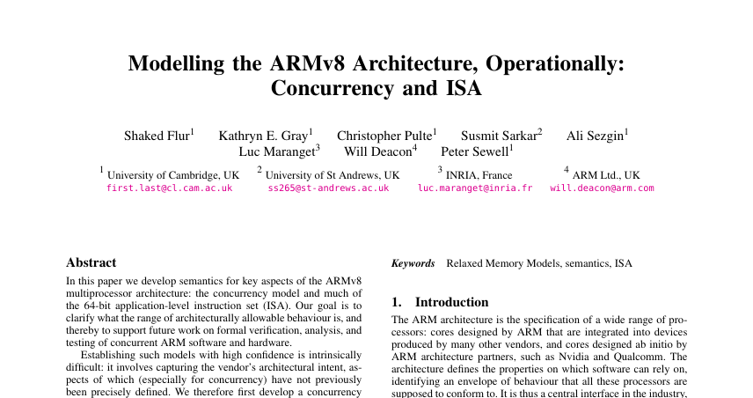
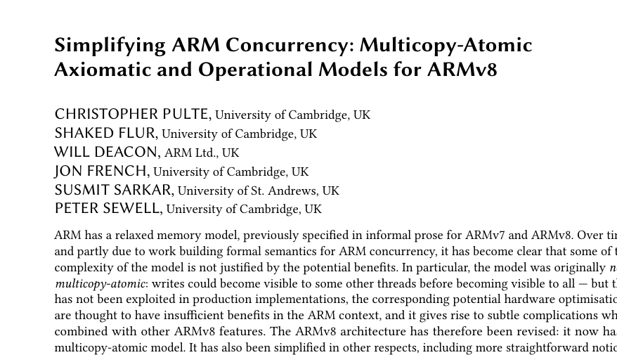
Relaxed (weak) Memory Model
RISC-V Weak Memory Ordering (RVWMO)
Processor Consistency (PC)
Release Consistency (RC)
…

Slide 55
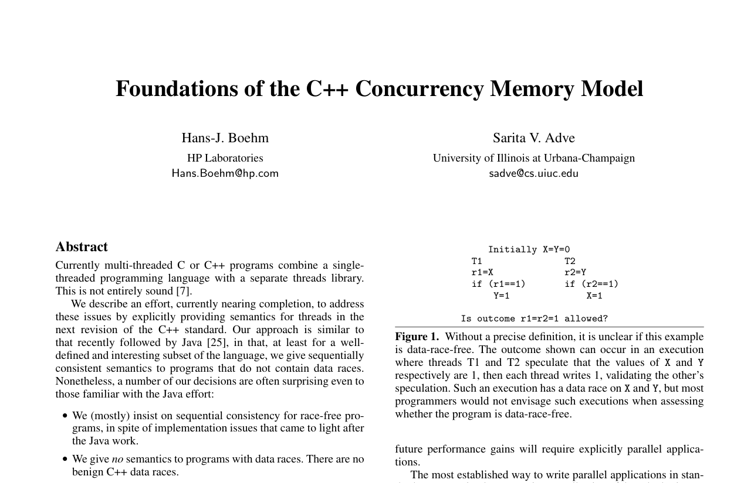
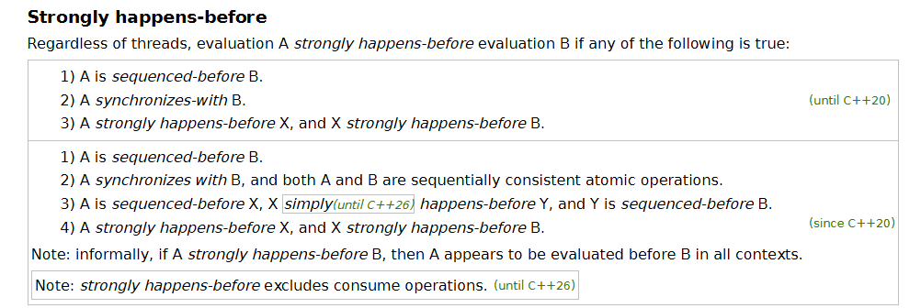
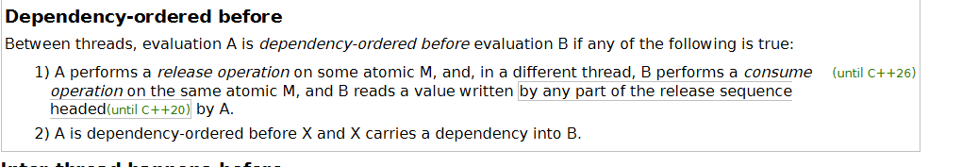
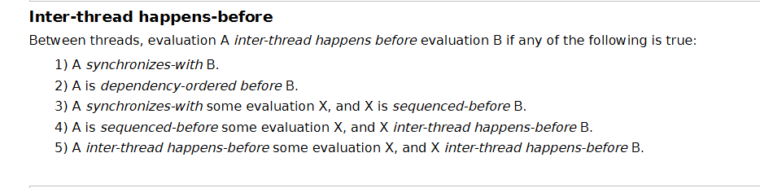
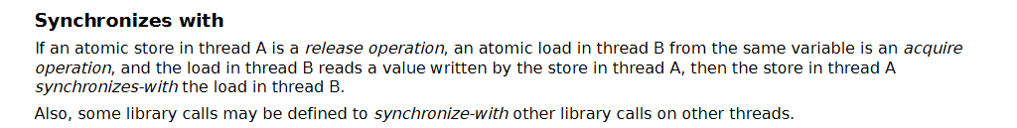
C++ Memory Model
Data conflict
Data race

Slide 56
C++ Memory Model
HW mem models: “operational”
  Classifies concrete behaviors as allowed/forbidden

Slide 57
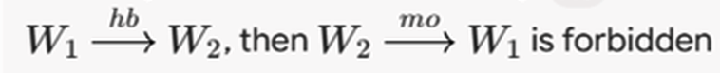
C++ Memory Model
C++ mem model: axiomatic
  Analyze an entire program, derive graphs for
  sequenced-before, modification-order, lock-order…
  A ‘candidate execution’ is allowed if it satisfies a set of consistency predicates. Ex:
  If no candidate execution does: the entire program is UB

Slide 58

https://www.cl.cam.ac.uk/~pes20/rems/

Slide 59
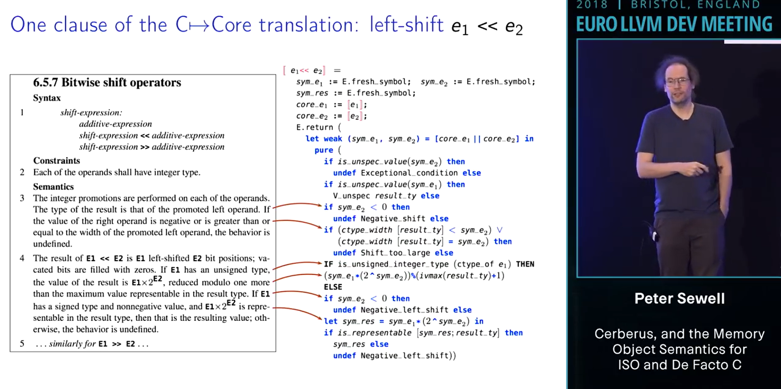
REMS

Slide 60
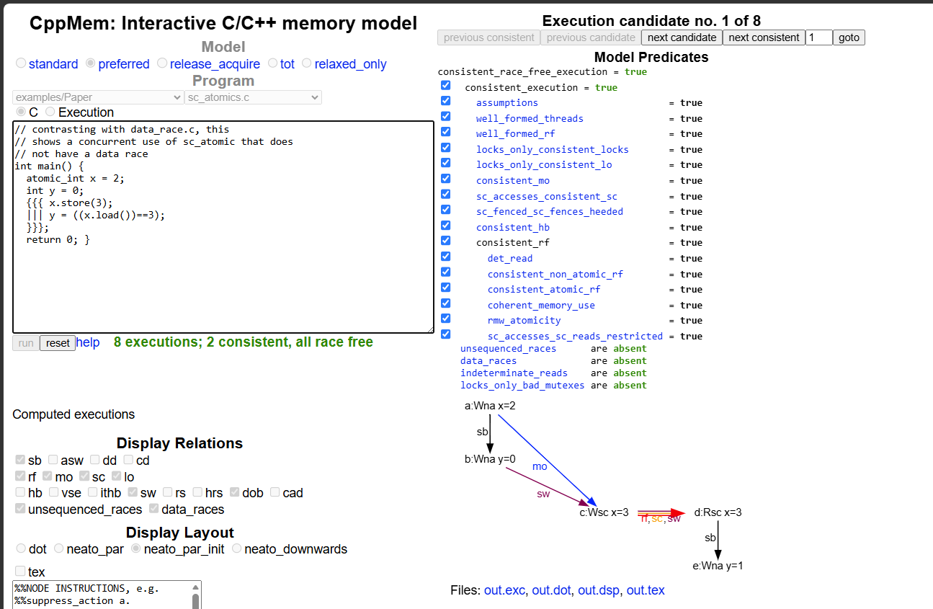
REMS
http://svr-pes20-cppmem.cl.cam.ac.uk/cppmem/

Slide 61
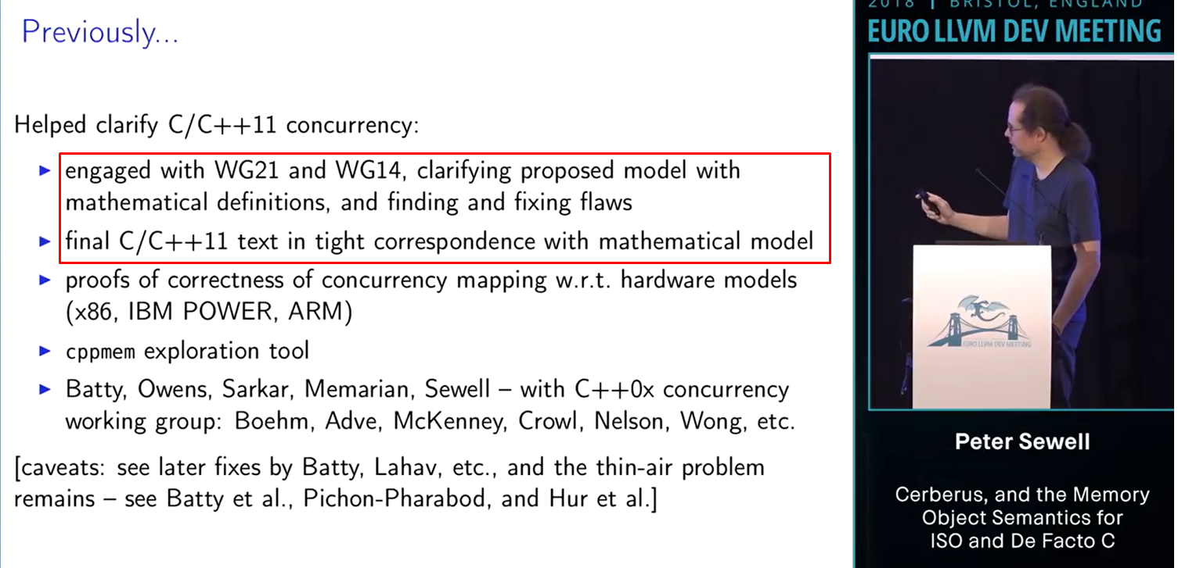
REMS

Slide 62
Out-of-Thin-Air (OOTA)
x = 0, y = 0
if (x == 1)
if (y == 1)
y = 1;
x = 1;
Allowed result: x = 1, y = 1
??

Slide 63

Out-of-Thin-Air (OOTA)
x = 0, y = 0
if (x == 1)
if (y == 1)
Optimizing compiler
y = 1;
x = 1;
x = 1;
else
x = 1;
Allowed result: x = 1, y = 1
!!

Slide 64
Summary
Different cores can have different views of memory because:
  Reasons
Software solves these problems by:
  Fences
  RMW
  OS level locks: futexes, mutexes etc.
Memory Models
  Your effort is probably better spent on understanding HW memory models

Slide 65




Thanks for listening!
We’re recruiting!
OfekShilon @

Slide 67
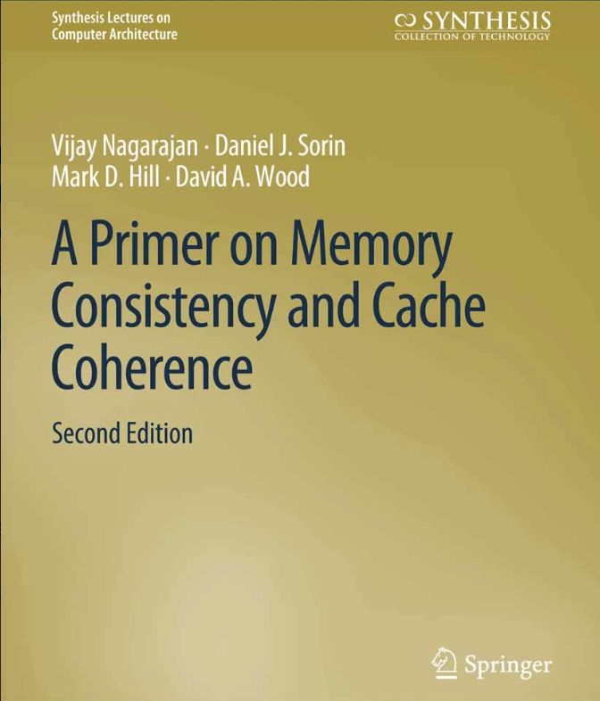
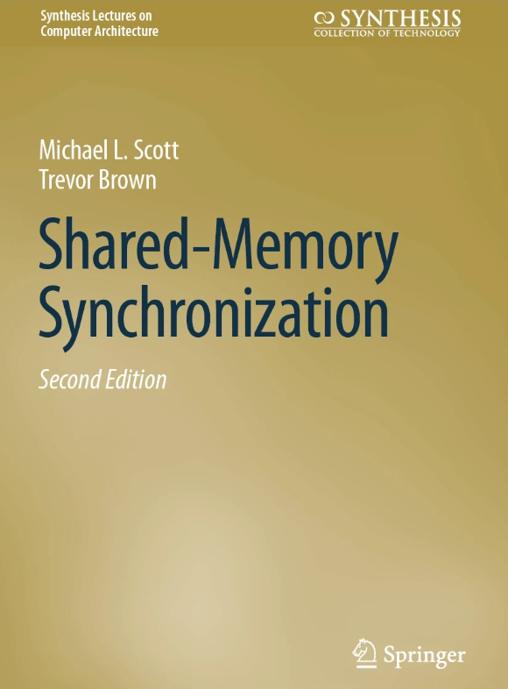




Resources
High Performance Computer Architecture – Free online course by
Milos Prvulovic of GeorgiaTech

Slide 68
C++ Memory Model
Sequential-Consistency for Data-Race-Free (SC-DRF)
  If the program has no data races, execution would appear to all threads as some interleaving of thread program-orders.
If a program is data-race-free, isn’t that obvious?

Slide 69
C++ Memory Model
Two threads accessing the same memory, at least one of them writing to it
Two threads accessing the same memory, at least one of them writing to it, with no happens-before relation between the operations
Data conflict
Data race

Slide 70
NT writes, Write-Combine Buffers
(Canonical) Example use case: zero a memory page
Telling the processor it is about to overwrite full cache lines
WCB: collect multiple writes before sending to the cache coherency system
Avoid the inefficient dance of RFO (Read-For-Ownership) request + modification + writeback.
MOVNT* instructions, do not undergo the usual coherency route – may be visible only some time in the future.

Slide 71
Fences: Implicit
Instructions with some order-serialization side effects:
  x86/64:
    CPUID, IRET, RSM, LOCK *, …
  ARM:
    MSR, MRS, ERET, SVC, HVC, SMC …

Slide 72
Fences: Store
X86-64: SFENCE
  Controls completion
  Drain write buffer, stall until older stores are visible everywhere
  Reorder barrier
  Regular stores are already ordered! Mostly unneeded
  Impacts special non-cached store instructions (MOVNT*).
store
store

Slide 73
Fences: Load
x86/64: LFENCE
  Block a younger read from issuing until all older reads have completed
    Completed = issued + resolved cache misses + retired
  Block speculative execution past the fence
    only in recent generations – 2018+ (since Spectre)
load
load

Slide 74
Terminology
Allocate, Dispatch
Issue
Dispatch
Commit
Execute, Issue
Complete, Retire, Graduate

Slide 75


